Slide 1
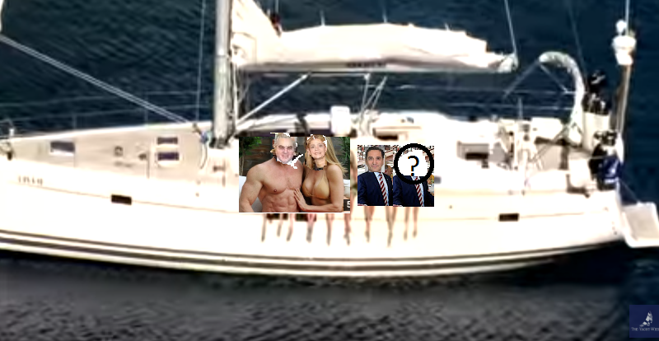

The Bot-People: your travel bot
Principles : what it does
Demo: how it works
How to do it: programming platforms

Slide 2
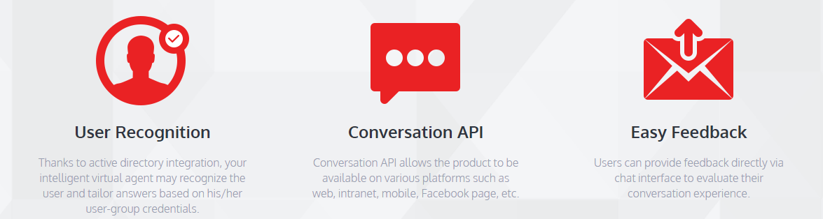
Principles : what it does
I am your Travel-Bot and will book for you the best flight, hotel experience & the car you want while making sure you are safe thanks to a great travel insurance

Slide 3
I know who you are, your preferences, if you are a leisure or business traveler, if you are looking for the cheapest deal or the most glamorous experience
Our conversation together will be fruitful and after a few quick exchanges, you will receive the best offer, fitting your preferences

Slide 4
DURING AND AFTER YOUR TRIP
Please send us your feedbacks:
Send us pictures, comments, blogs and articles about your feelings ……
For example ….
HOW WAS THE BAR AT THE HOTEL?

Slide 5
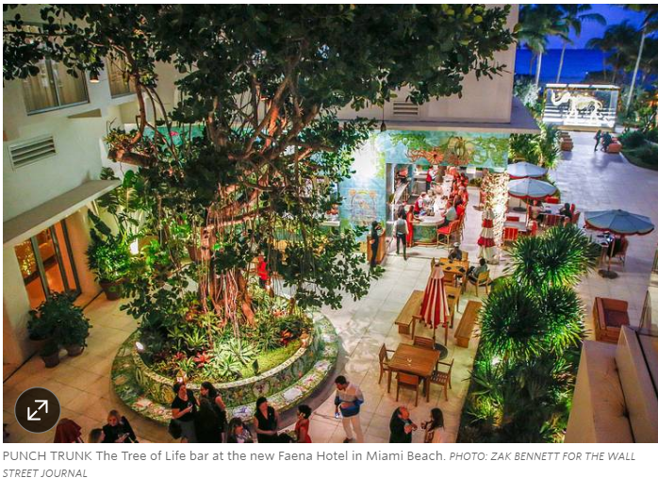
Hotel Bars You’ll Want to Build a Trip Around: A Tippler’s Guide Forget the pool, spa, views. These days more travelers are choosing hotels expressly because of their magnetic bars. Here, the best of the new-breed of hotel watering holes, from Amsterdam to Abu Dhabi
https://www.wsj.com/articles/hotel-bars-youll-want-to-build-a-trip-around-a-tipplers-guide-1488481537

Slide 6




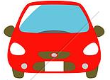

2. Demo: how it works
Hi, I want to fly to Mumbay on March 1st and come back on March 15th
I am travelling with my wife
I am Luke, you travel advisor,
Welcome … at any time, you can click on icons for fligths, hotels, car rentals and travel insurance
Sure I will find you the best flight.
I see that you are in New York, so I will look for flights out of New York … correct?
Yes
Ok ……. Searching ……

Slide 7
Principles : what it does
Hi, I want to fly to Mumbay on March 1st and come back on March 15th
I am travelling with my wife
I am Luke, you travel advisor,
Welcome … at any time, you can click on icons for fligths, hotels, car rentals and travel insurance
Sure I will find you the best flight.
I see that you are in New York, so I will look for flights out of New York … correct?
Yes
Ok ……. Searching ……

Slide 8
Here are the top 10 flights I found for you:
SELECT
JFK-BOM Air China $550
JFK-BOM Turkish $612
JFK-BOM Kuwait $650
EWR-BOM Air India (direct) $762
EWR-BOM United (direct) $790
JFK-BOM Emirates $778
JFK-BOM Air India $767
JFK-BOM Etihad $776
JFK-BOM Swiss $805
JFK-BOM Lufthansa $830
I am Luke, you travel advisor,
Welcome … at any time, you can click on icons for fligths, hotels, car rentals and travel insurance
Click to GO!

Slide 9



Air China great choice!
You are leaving from JFK on Air China flight 982 on Wed 3/1 at 3:50pm and arriving in Mumbai on Fri 3/3 at 1:00am (22h40m).
Short connection in Beijing (PEK).
I am Luke, you travel advisor,
Welcome … at any time, you can click on icons for fligths, hotels, car rentals and travel insurance
Yes, book it !
No back…

Slide 10
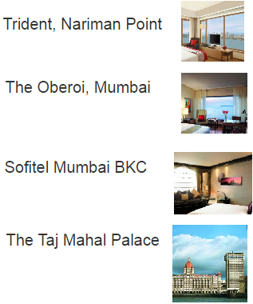
Great flight is booked!!!
I also have great hotels in Mumbai:
$175 / night
I am Luke, you travel advisor,
Welcome … at any time, you can click on icons for fligths, hotels, car rentals and travel insurance
$250 / night
$198 / night
$400 / night
No back…
More..
back
more

Slide 11
The 555 luxury rooms and suites at Trident, Nariman Point, offer stunning views of the ocean and the five star Mumbai city skyline ….
Queen Size bed is okay?
I am Luke, you travel advisor,
Welcome … at any time, you can click on icons for fligths, hotels, car rentals and travel insurance
No, King Size non-smoking
Great! How many nights ? Checking on 3/3?
No 5 nights starting 3/6
Your booking ref. is AJW5KL87
The hotel is expecting you, 5 nts x 178$ = $890, free breakfast ;
Do you need a car ?

Slide 12
You should consider a Travel Insurance covering: we offer Global Assistance with Allianz for Emergency Medical, Evacuation, Rapatriation ($65/day)
I am Luke, you travel advisor,
Welcome … at any time, you can click on icons for fligths, hotels, car rentals and travel insurance
Yes!!!
You got it: $65 * 15 days = $975
FOR EMERGENCY ASSISTANCE
DURING YOUR TRIP CALL:
1-800-654-1908
(From U.S.)
1-804-281-5700
(Collect)
Policy No.: INSP2081707639
https://www.allianztravelinsurance.com/account/policies/manage?pol=LkR5CWxL%2fM79zdlQx7DTYg%3d%3d&purch_date=01/10/2017

Slide 13


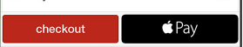
Great, you are good to go:
Total Transaction is:
Flights 550$ * 2 pax = $1100
Hotel 5 nts x 178$ = $890
Car 12 days * $96 = $1152
Allianz Travel Insurance = $975
*** TOTAL: $4117 ***
I am Luke, you travel advisor,
Welcome … at any time, you can click on icons for fligths, hotels, car rentals and travel insurance
we are offering you secure and convenient ways to pay

Slide 14

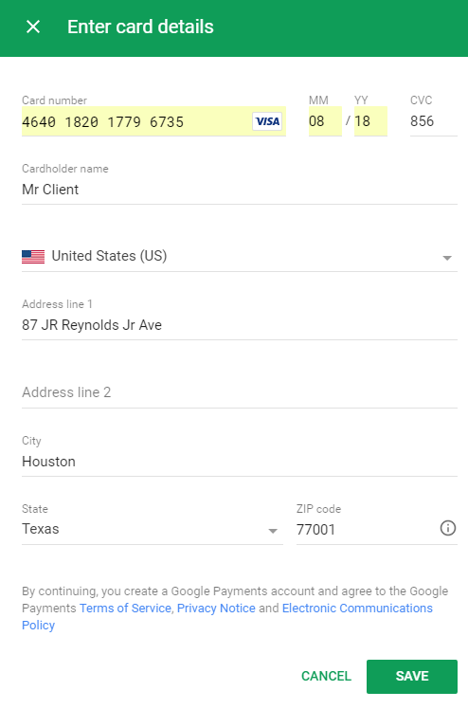
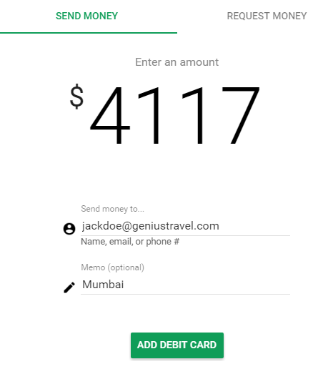

Slide 15
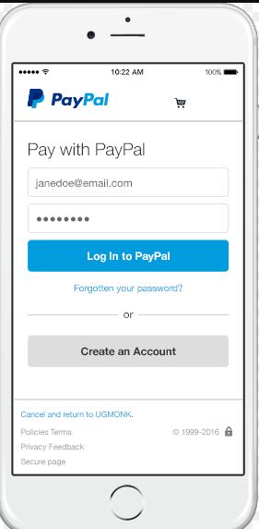
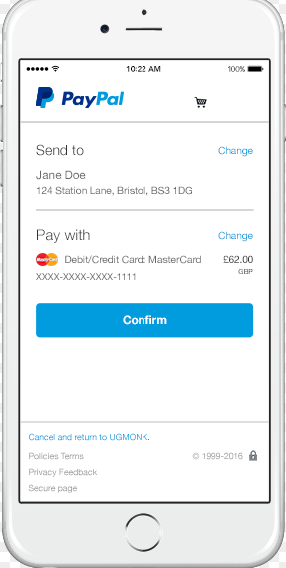
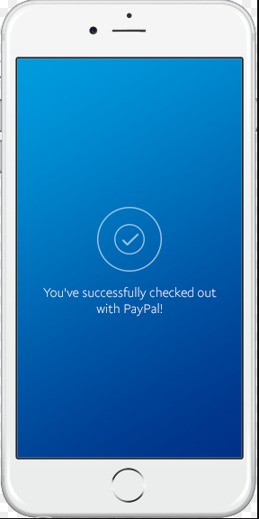
$4117
$4117

Slide 16
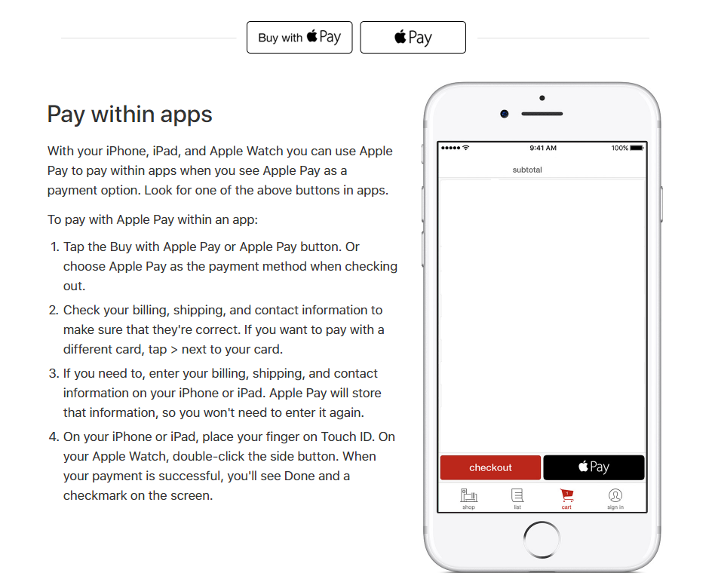
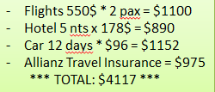
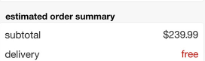
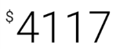

Slide 17
Thank you for your payment.
I would like to ask you if you like to share your experience with us: give us a feedback about your flight and your hotel, like did you …
I am Luke, you travel advisor,
Welcome … at any time, you can click on icons for fligths, hotels, car rentals and travel insurance
yes
Great I cannot wait to hear from you. … you can also send us pictures, tell us about the bar at the hotel

Slide 18
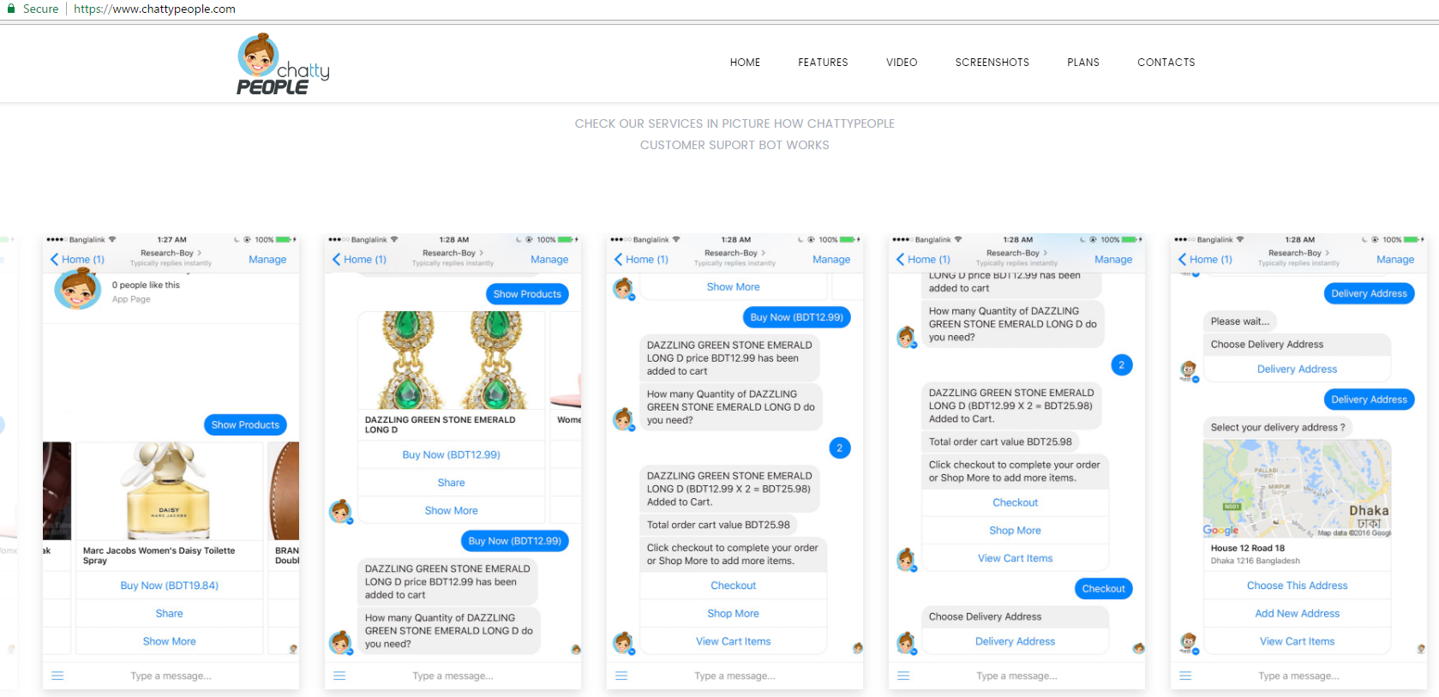
3. How to do it: programming platforms
Source: https://www.entrepreneur.com/article/289788

Slide 19
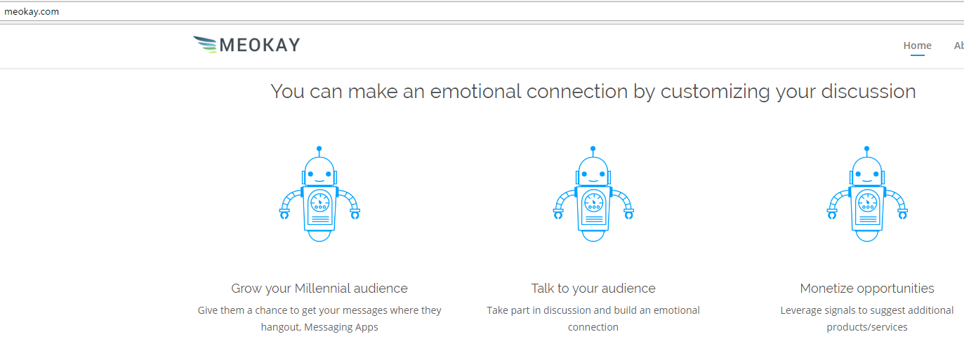
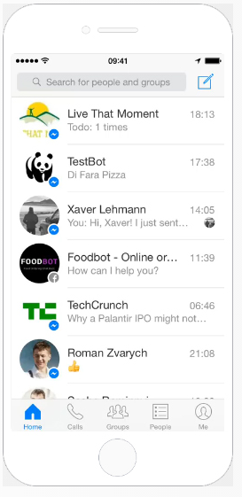
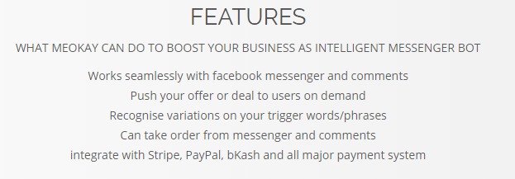

Slide 20
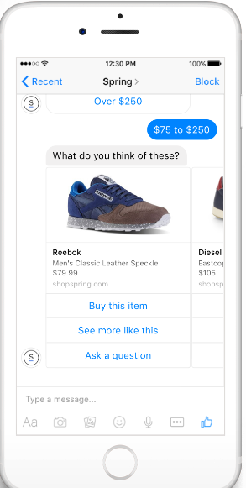
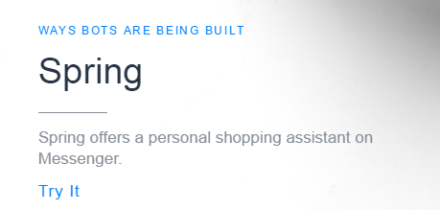
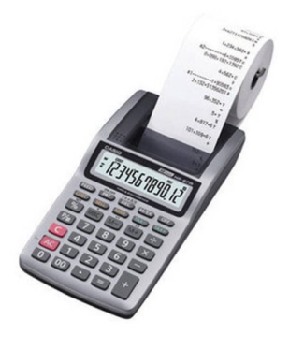

Slide 21

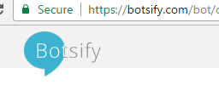

Other Choices of Platforms:
https://www.smooch.com/
https://botsify.com/
https://beepboophq.com/
https://chatfuel.com/

